Slide 1

Healthwatch Redbridge: Annual General Meeting
Welcome

Slide 2
Lorraine Silver
Chair - Healthwatch Redbridge
Welcome

Slide 3
Quick Housekeeping
We would be grateful if you would:
Place yourself on mute
Please raise your hand or use the chat box if you have a question
If the connection drops out, please allow five minutes for us to re-join.
This meeting is being video recorded and will be made available on our website.

Slide 4
Agenda
4.45pm Welcome & Housekeeping (5mins)
4.50pm Highlighting Heroes – presentations (15mins)
5.05pm Minutes of last meeting – December 2019 (5mins)
5.10pm Chief Executives Report (10mins)
5.20pm Audited Accounts (10mins)
5.30pm Appointment of the Auditors (5mins)
5.35pm Appointment of Directors (10mins)
5.45pm Any Other Business (10mins)
5.55pm Chairs closing remarks (5mins)
6.00pm Close

Slide 5
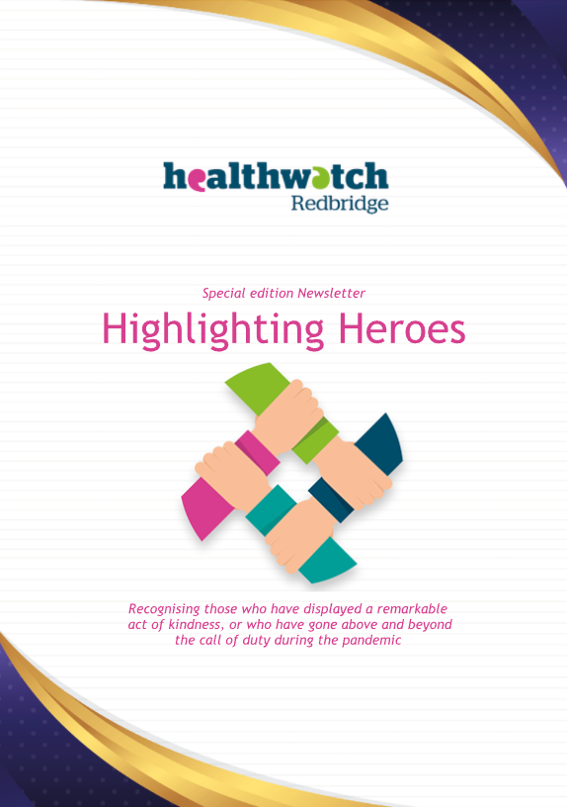
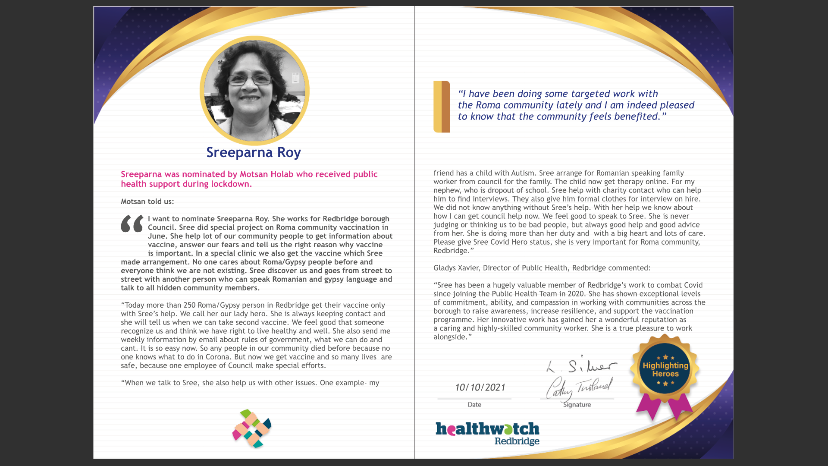
Highlighting Heroes
Recognising those who have gone above and beyond during the pandemic

Slide 6
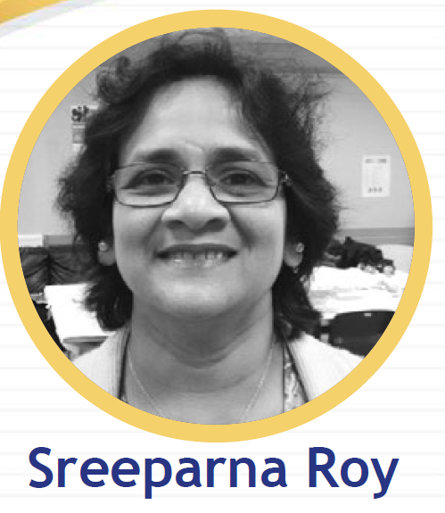
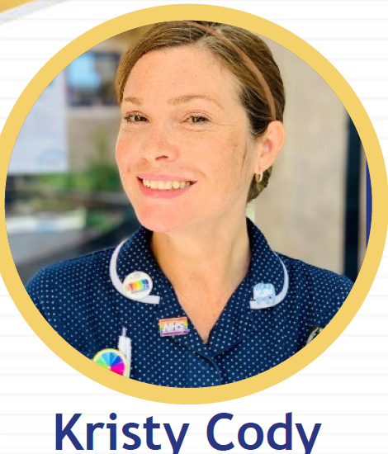
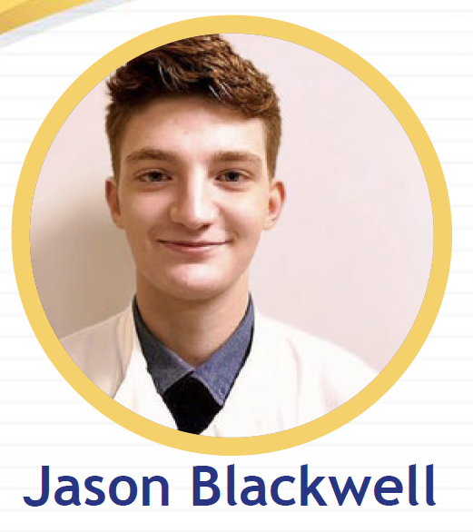
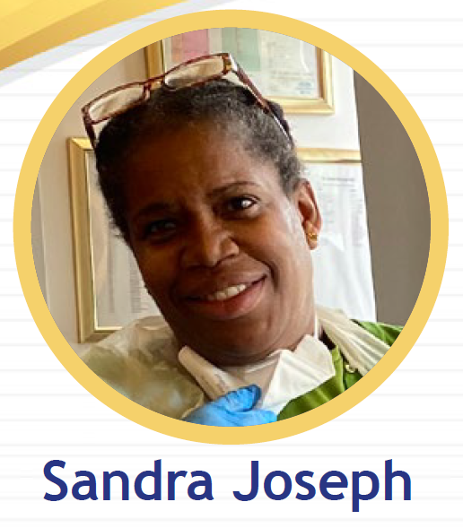
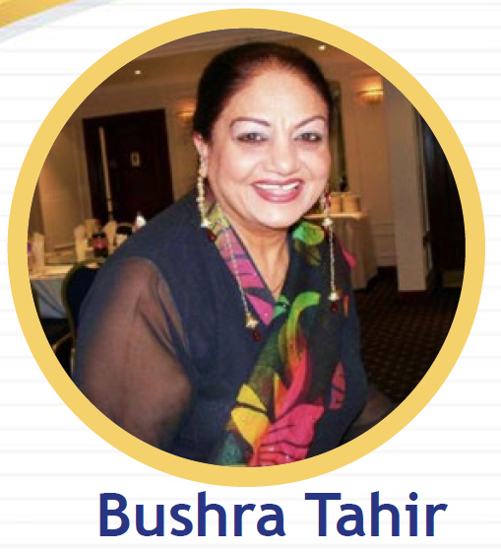
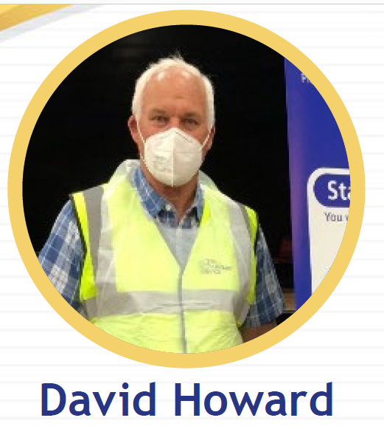
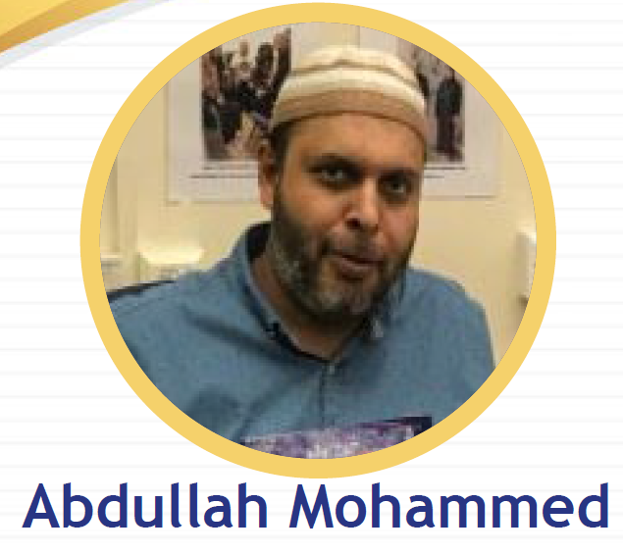
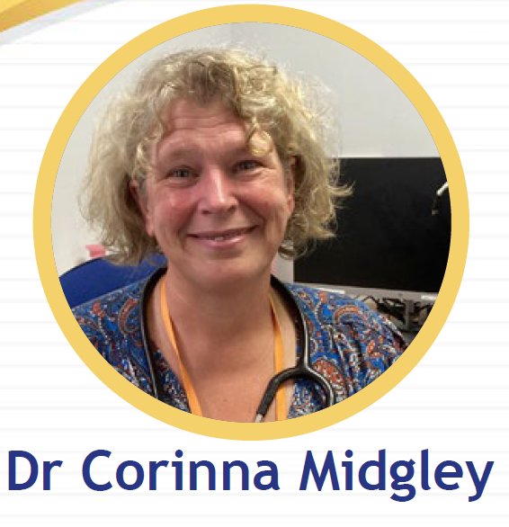
14 nominations have been included in our special newsletter
Some of our Nominees

Slide 7
Minutes of last meeting – 12 December 2019
Lorraine Silver
HWR Chair
Notes:
Highlights:
Successful tender bid
…..but with a large reduction in funding will mean we will have to review the way we are working
We launched our ‘User Friendly’ report in March last year, today Cathy will provide a short update
Innovative ways of working:
We launched our Community Cash Fund project which you have recently heard about

Slide 8
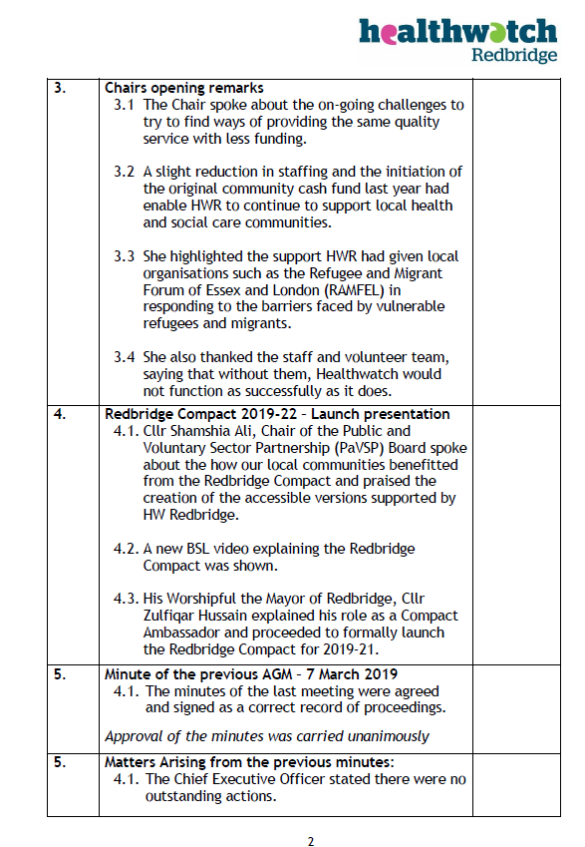


Slide 9
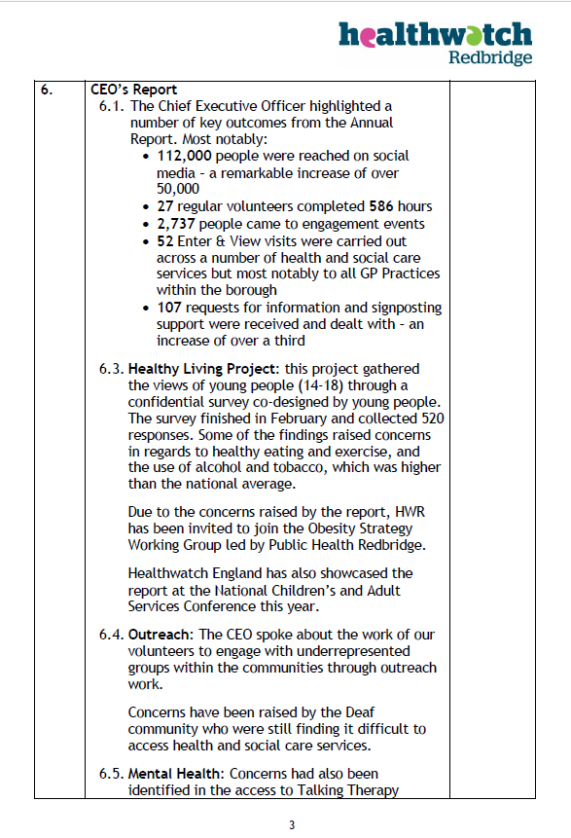
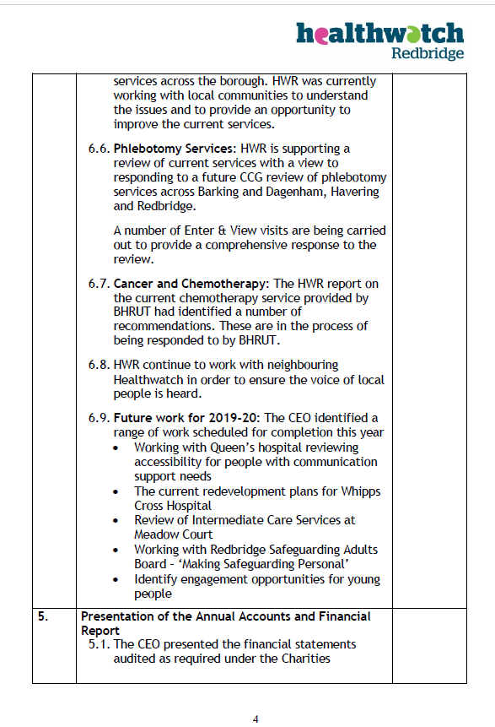

Slide 10
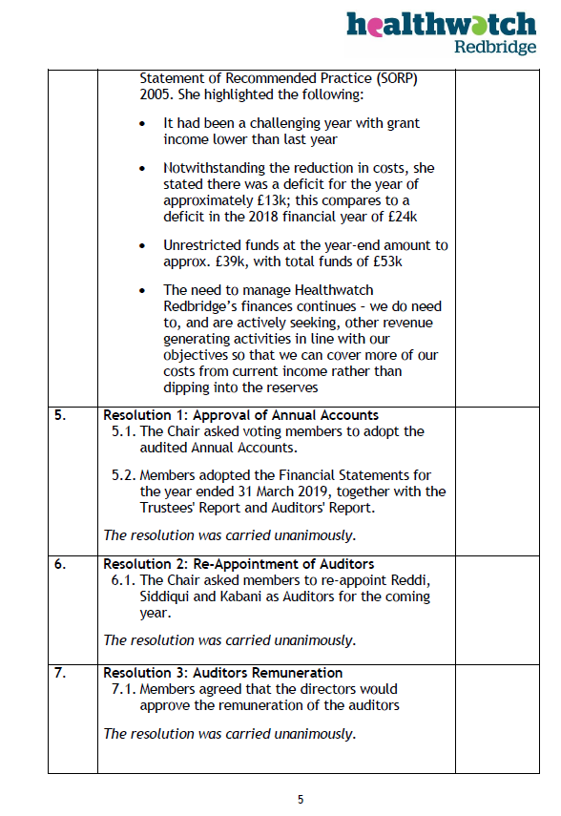
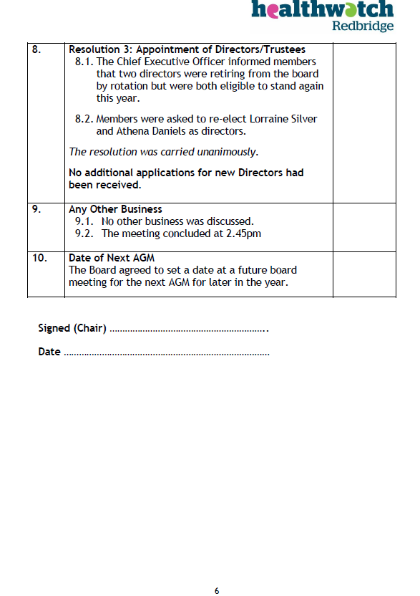

Slide 11
CEO Report
Cathy Turland
HWR Chief Executive Officer

Slide 12
Our Directors
Lorraine Silver – Chair
Mo Dedat
Athena Daniels
Emma Friddin – (co-opted member)
Our Staff
Cathy Turland – Chief Executive Officer
Miranda Peers – Volunteer Coordinator
Nat Cato – Information & Media Officer
Dawn Hobson – Projects Officer

Slide 13
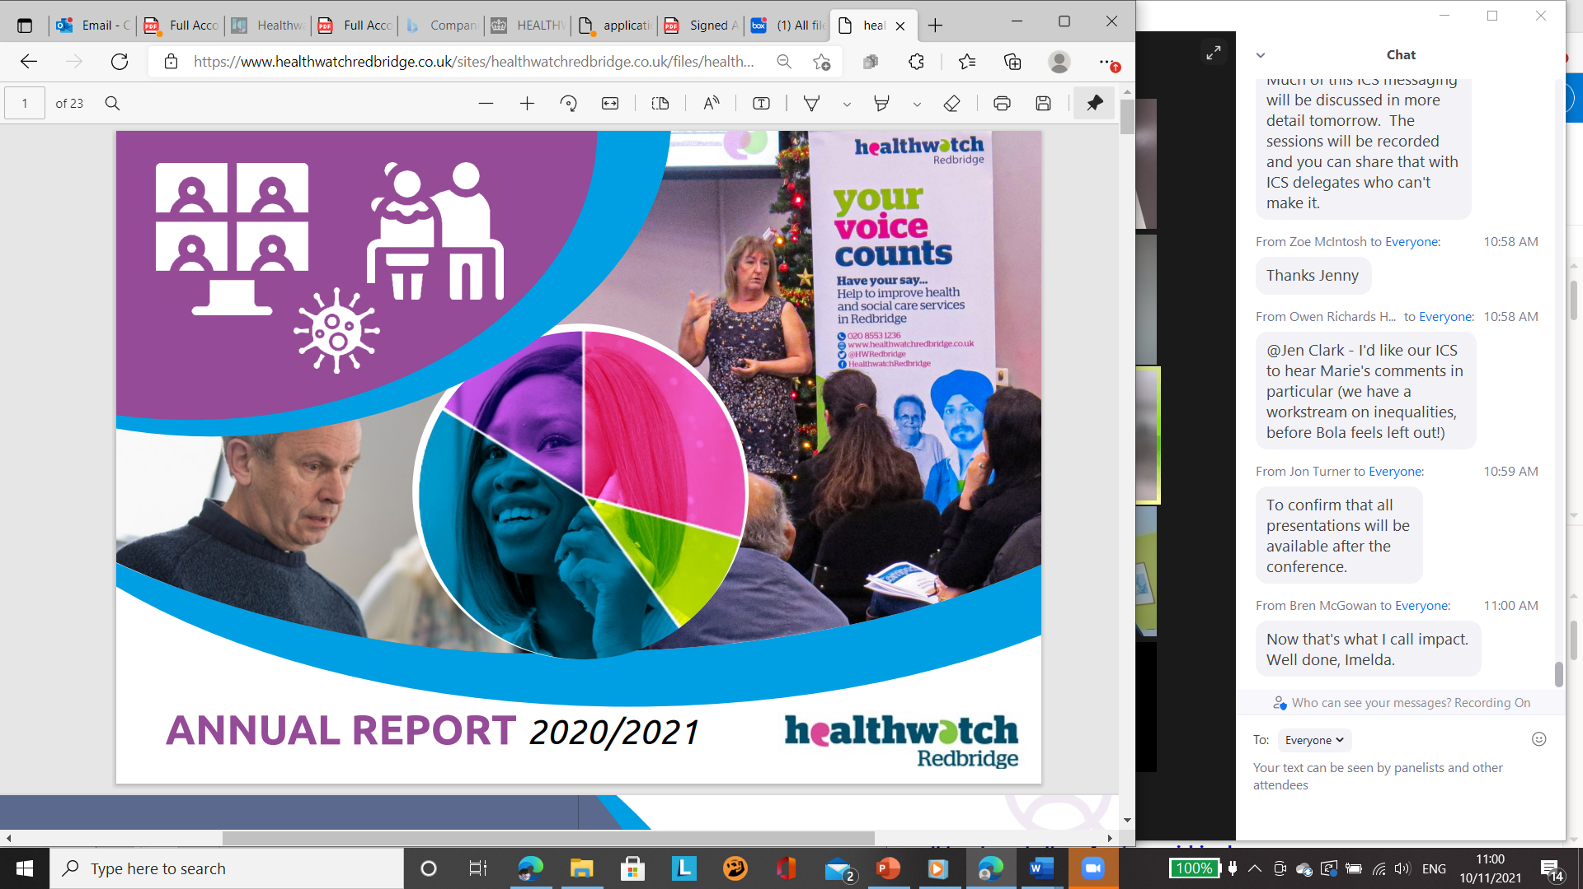
HWR Annual Report 2020-21
82 people met us in focus groups
870 people engaged
25 regular volunteers (743 hours)
6 Reports published
141 information and signposting support requests

Slide 14
Work Plan priorities 2020/21
COVID-19 projects:
Hospital Services - DNR Concerns
Care Homes – COVID concerns
Phlebotomy services
Accessing GP services:
      Appointments
      website and online services
Covid-19 Survey
Vaccine Hesitancy
Accessible Information Standards – Barts Health
Disabled People’s Covid Survey – across NEL
Notes:
Work Plan 20/21
Each year, we create our work programme based on a review of issues we are made become aware of during
the previous year. This year, due to limitations imposed upon us by the pandemic, we became more reactive
to issues mainly caused by the results of Covid-19. We listened to the issues being raised and reacted
accordingly, which is reflected in the areas covered within our work programme.
This year, our board approved the following work programme areas:
COVID-19 projects
As part of the multi-agency COVID response; Healthwatch Redbridge was part of the councils’
COVID-19 Pandemic Committee which helped us highlight current local issues or concerns related to
the pandemic and feed them into the recovery model.
Hospital Services - DNR Concerns:
In early April, concerns were raised by relatives regarding Do Not Resuscitate (DNR) requirements. The issue
was identified by several Healthwatch organisations across the country and raised with the Department of
Health by our national umbrella organisation Healthwatch England. As a direct response of local Healthwatch
input, the regulations were reviewed and clarified for all NHS trusts giving relatives and health workers clarity
when dealing with what were extremely stressful situations.
Care Homes – COVID concerns
Although national guidance required all hospital patients to be tested for COVID prior to discharge; we
were alarmed to discover many vulnerable patients were being discharged before the outcome of the
test was known. By carrying out telephone surveys with many care and nursing home managers, we
were able to highlight issues and enable the right support and information to be made available.
Phlebotomy services
Many people started to contact us, increasingly concerned that they were unable to book essential
phlebotomy services (blood test) across the borough. By investigating the issues raised, we were able
to improve the level of phlebotomy services in the borough.
Accessing GP services - appointments
Many people raised concerns regarding the access to appropriate GP appointments. Some were
concerned they were unable to request face to face appointments when they felt they were necessary.
With the help of our volunteers, we contacted most practices to identify how patients could access the
service and developed a raft of recommendations.
Accessing GP services – website and online services
We also reviewed the online services offered by GP’s. We audited the current provision and have made
several recommendations for improvements.
Covid-19 Survey
We created a public survey to ask people how the pandemic had affected them. This work helped us to
provide a local response, but also fed into the national campaign BecauseWeAllCare led by HW
England. A number of issues emerged which are explained in our Annual Report:
HEALTHWATCH REDBRIDGE
TRUSTEES' REPORT (INCLUDING DIRECTORS' REPORT) (CONTINUED)
FOR THE YEAR ENDED 31 MARCH 2021
- 4 -
Vaccine Hesitancy
With the introduction of the long-awaited COVID-19 vaccine, we were made aware that some
communities and individuals were expressing a reluctance in having the vaccination. This was
particularly reflected within some of our ethnic minority communities. Our report was used by our Public
Health Team to target their information and support response.
Accessible Information Standards – supporting Barts Health
Last year, we carried out an access audit within Queen’s Hospital in Romford, working with some of our
volunteers with communication support needs. This work was widely commended and led to changes
being made to ensure Deaf and disabled people were given information in appropriate formats.
This year, we began working on a similar audit with Whipps Cross hospital. However, this has been
delayed due to the pandemic. We are fortunate that we have also been able to include students from
Queen Mary University London, who were interested in carrying out some of the work as part of their
final year of a BSc in Global Health studies. Students conducted a small online review, and we are
preparing to carry out a wider review this year.

Slide 15
This year’s work 2021/22
Projects:
Community Insights Project
Dentistry Project
Whipps Cross Redevelopment
Making Safeguarding Personal
Reviewing the effects of Long Covid
Accessible Information Standards – Barts Health (Pt 2
Maternity services – concerns from Afro Caribbean communities
Roma Communities – barriers to accessing health and care services
Notes:
Work Plan 20/21
Each year, we create our work programme based on a review of issues we are made become aware of during
the previous year. This year, due to limitations imposed upon us by the pandemic, we became more reactive
to issues mainly caused by the results of Covid-19. We listened to the issues being raised and reacted
accordingly, which is reflected in the areas covered within our work programme.
This year, our board approved the following work programme areas:
COVID-19 projects
As part of the multi-agency COVID response; Healthwatch Redbridge was part of the councils’
COVID-19 Pandemic Committee which helped us highlight current local issues or concerns related to
the pandemic and feed them into the recovery model.
Hospital Services - DNR Concerns:
In early April, concerns were raised by relatives regarding Do Not Resuscitate (DNR) requirements. The issue
was identified by several Healthwatch organisations across the country and raised with the Department of
Health by our national umbrella organisation Healthwatch England. As a direct response of local Healthwatch
input, the regulations were reviewed and clarified for all NHS trusts giving relatives and health workers clarity
when dealing with what were extremely stressful situations.
Care Homes – COVID concerns
Although national guidance required all hospital patients to be tested for COVID prior to discharge; we
were alarmed to discover many vulnerable patients were being discharged before the outcome of the
test was known. By carrying out telephone surveys with many care and nursing home managers, we
were able to highlight issues and enable the right support and information to be made available.
Phlebotomy services
Many people started to contact us, increasingly concerned that they were unable to book essential
phlebotomy services (blood test) across the borough. By investigating the issues raised, we were able
to improve the level of phlebotomy services in the borough.
Accessing GP services - appointments
Many people raised concerns regarding the access to appropriate GP appointments. Some were
concerned they were unable to request face to face appointments when they felt they were necessary.
With the help of our volunteers, we contacted most practices to identify how patients could access the
service and developed a raft of recommendations.
Accessing GP services – website and online services
We also reviewed the online services offered by GP’s. We audited the current provision and have made
several recommendations for improvements.
Covid-19 Survey
We created a public survey to ask people how the pandemic had affected them. This work helped us to
provide a local response, but also fed into the national campaign BecauseWeAllCare led by HW
England. A number of issues emerged which are explained in our Annual Report:
HEALTHWATCH REDBRIDGE
TRUSTEES' REPORT (INCLUDING DIRECTORS' REPORT) (CONTINUED)
FOR THE YEAR ENDED 31 MARCH 2021
- 4 -
Vaccine Hesitancy
With the introduction of the long-awaited COVID-19 vaccine, we were made aware that some
communities and individuals were expressing a reluctance in having the vaccination. This was
particularly reflected within some of our ethnic minority communities. Our report was used by our Public
Health Team to target their information and support response.
Accessible Information Standards – supporting Barts Health
Last year, we carried out an access audit within Queen’s Hospital in Romford, working with some of our
volunteers with communication support needs. This work was widely commended and led to changes
being made to ensure Deaf and disabled people were given information in appropriate formats.
This year, we began working on a similar audit with Whipps Cross hospital. However, this has been
delayed due to the pandemic. We are fortunate that we have also been able to include students from
Queen Mary University London, who were interested in carrying out some of the work as part of their
final year of a BSc in Global Health studies. Students conducted a small online review, and we are
preparing to carry out a wider review this year.

Slide 16
Audited Accounts for 2020-21
Mo Dedat
HWR Director

Slide 17
Appointment of Auditors
Lorraine Silver
HWR Chair
Notes:
The board wish to re-appoint Reddy, Siddiqui LLP as their preferred auditors for this year.

Slide 18
HWR Director:
Appointment of eligible Directors
Cathy Turland
HWR CEO

Slide 19
Retiring by rotation:
Mo Dedat
Appointment of new Directors:
Emma Friddin

Slide 20
Any other business
Lorraine Silver
HWR Chair

Slide 21
Closing remarks
Lorraine Silver
HWR Chair

Slide 22




Thank You
 | info@healthwatchredbridge.co.uk
 | 020 8553 1236
 | @HWRedbridge
 | Healthwatch Redbridge

