Slide 1
The Togetherness Café
Final Impact Report
Submitted by Shahid Mahmood, Blossom Group ASA CICFunded by Healthwatch Redbridge | Award: £2,000

Slide 2
Executive Summary: Delivering on Every Promise
Over 10 weeks, The Togetherness Café created a culturally competent safe space for seldom-heard South Asian, African, and Afro-Caribbean communities in Redbridge. We didn't just meet our objectives—we exceeded them, uncovering entrenched health inequalities whilst providing practical support communities urgently needed.
200+
38+
Community members engaged across 10 sessions
Individuals supported through 1:1 advice sessions
100%
This project reached further and deeper than anticipated, empowering marginalised voices to navigate health systems, identifying systemic barriers through lived experience, and developing actionable recommendations for service transformation.
Participants asked us to continue beyond 10 weeks

Slide 3

Objective 1: Empowering Navigation of Health Systems
What We Promised
What We Delivered
Help participants gain confidence navigating health services and access practical support to overcome systemic barriers.
We launched the Community Box Advice Service in Week 5—a transformative turning point. This provided over 38 individuals with culturally competent 1:1 support in Urdu, Punjabi, Arabic, and Somali.
Direct Support Included:
Registering with GPs, dentists, and mental health services
Explaining rights in plain, accessible language
Booking appointments and navigating the NHS App
Translating health letters and referral documents
Completing Universal Credit,HC2, PIP, and other benefit forms
Building confidence for independent health management
Impact: Previously disengaged participants began re-engaging with health systems. Several now confidently manage their own appointments and understand their healthcare rights.

Slide 4




Objective 2: Identifying Deep-Rooted Health Inequalities
We gathered unfiltered feedback through multiple channels, combining qualitative depth with quantitative reach to surface systemic inequalities affecting marginalised communities.
Our Methodology
110+ multilingual surveys capturing quantitative data
87%
24 in-depth interviews with vulnerable participants
10 focus groups discussing GP access, mental health, cultural safety, housing, and discrimination
Weekly feedback sessions documenting lived experiences
We didn't just document inequalities—we responded to them in real time, building trust and practical solutions through the Café itself.
Poor Mental Health
Reported very poor mental wellbeing
88%
Systemic Racism
Believed racism embedded in health services
70%
100%
Digital Exclusion
Phone Access Failure
Lacked digital access to services
Could not reach services by phone

Slide 5
Understanding Our Community: Who We Reached
67% Women
42% Disabled
91% Housing Insecurity
Majority female participants, reflecting gendered barriers to healthcare access
Nearly half identified as disabled, yet lacked tailored support from services
Believed they would never own a home, with housing linked to worsening mental health
Cultural Representation
Our reach reflected Redbridge's diverse communities: 32% Pakistani, 19% Black African, 13% Indian, and 9% Afro-Caribbean participants. The majority came from low-income households facing multiple, intersecting barriers to health and wellbeing.

Slide 6
Objective 3: Amplifying Marginalised Voices
Authentic, Community-Led Feedback
"87% of attendees said they felt seen and heard for the first time. This wasn't consultation—this was genuine partnership and co-design."
We collected lived experiences weekly through methodical, trauma-informed approaches—not tokenistic consultation. Every voice mattered, and every story was documented with dignity and consent.

Slide 7
Objectives 4 & 5: Participation and Wellbeing Transformation
Health & Wellness Workshops
Peer Support Groups
Co-Designed Initiatives
Bi-monthly sessions covering mental health, nutrition, NHS navigation, and self-advocacy—delivered in culturally safe, accessible ways with translated materials.
Mental wellbeing circles led by and for BME communities, normalising mental health conversations and reducing isolation through shared experience.
Sessions and materials led by community voices, not outsiders. An Advisory Board is now forming to continue community influence beyond the project.
Measurable Wellbeing Impact
87%
30+
The Café created a weekly safe space where trust was rebuilt, isolation reduced, and hope restored. Attendance grew steadily, especially after launching the Advice Service—proving both value and urgent community demand.
Felt Seen & Heard
Digital Confidence
For the first time in their healthcare journey
Now use NHS App or GP online systems
12%
Rebuilding Trust
Now trust some health providers (up from 0%)

Slide 8





Health-Focused Recommendations for System Change
Rooted in participant experiences, these recommendations offer practical, achievable ways for health services to improve equity and access. They represent the collective voice of over 100 marginalised community members.
Fund Local Community Navigators
Mandatory Anti-Racism Training
Restore Face-to-Face Access
Base culturally competent staff in GP surgeries and libraries to help with forms, online access, translation, and follow-up support.
Delivered by community groups, not consultants. Focus on lived experience and cultural humility, not just policy compliance.
Digital-only models exclude the most vulnerable. Reopen local access points with live staff who speak community languages.
Invest in Peer-Led Mental Health Spaces
End Tokenism—True Co-Design
Co-designed circles facilitated by and for BME communities, with proper clinical referral pathways and ongoing funding.
Include community members as equal partners in service design, not just focus group attendees. Pay them fairly for their expertise.

Slide 9
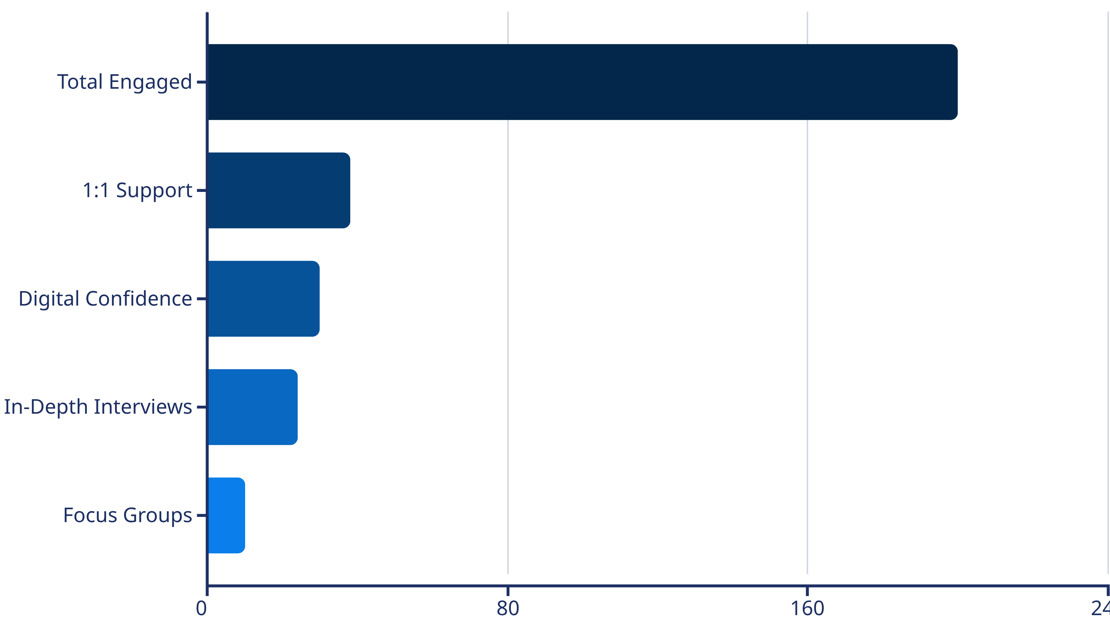
Impact at a Glance: Measurable Outcomes
Qualitative Transformation
Community Voice: "For the first time, someone asked what we needed—not what they thought we should have. That changed everything."
100% of sessions produced written or verbal feedback
87% reported reduced isolation and improved mental wellbeing
100% said they felt respected and culturally understood
5 evidence-based recommendations developed for system change

Slide 10
The Journey Continues
The Togetherness Café proved that when you create culturally safe spaces, listen authentically, and respond with practical support, transformation happens. This isn't the end—it's the beginning.
100% of Participants
Advisory Board Forming
Sustained Impact Vision
Asked us to continue the Café beyond the initial 10 weeks—a testament to urgent, unmet need.
Community members are now co-designing the future of this work as equal partners, not recipients.
We're seeking ongoing funding to embed this model permanently in Redbridge's health ecosystem.
Thank you to Healthwatch Redbridge for trusting us to deliver this vital work. Together, we've demonstrated that meaningful community engagement, rooted in lived experience and cultural competence, can transform health inequalities into health equity.
For more information, contact Shahid Mahmood, Blossom Group ASA CIC

